Slide 1


Meet the Teacher
Everyday Excellence in Year 6
Parents are invited to come along to discuss new year group expectations for children in Year 6 in September on Tuesday the 14th of July.
If unable to attend, a copy of information shared will be posted via class dojo.

Slide 2
Meet the Teacher
Everyday Excellence in Year 6
Class teacher: Mr Seaman

Slide 3

Our vision:

Slide 4

Our vision:
Growing every learner to be the very best version of themselves…

Slide 5
School Expectations
Class Expectations
Year 6 Curriculum
Questions

Slide 6
School Expectations
Attend school every day
Lateness really impacts – be ready, be on time – everyday attendance
School uniform
Correct PE kit – information to be given on the days for this.
Enrichment
Home-school agreement
Reading – every school day – 5 minutes (at least), 5 times a week
Spellings – practise at home
Progress sharing – reports termly
Effective Parent-Teacher partnership is crucial to ensure
your child makes progress

Slide 7



Slide 8


Our school values

Slide 9
Key Stage 2 – Year 6
A broad and balanced curriculum offer
Writing
Mathematics
Reading
PE – twice weekly
Art and Design
Religion
History and Geography
PSHE
Music
French
Science
Forest School opportunity
Residential
Personal Development

Slide 10
Year 6 is all about…
Residential
Leavers production and hoodies
Leadership opportunities
Trust Sports competition
Transition to Secondary School
SATs

Slide 11

Year 6 SATs
End of Key Stage 2
SATS May 2027
Teacher Assessment and scaled scores
Adapted support available
National Standard:
Spelling and Grammar SS – 80-99 = WT SS – 100 = EXP SS – 101-120 = AB | Reading SS – 80-99 = WT SS – 100 = EXP SS – 101-120 = AB | Maths SS – 80-99 = WT SS – 100 = EXP SS – 101-120 = AB | Writing Teacher assessment: WT EXP GD

Slide 12

Learning at Asterdale…
Enrichment is at the heart of our curriculum approach
Enrichment – PD programme
Experiences – Trips and residential
Connections – Thrive, MyHappyMind and OPAL

Slide 13
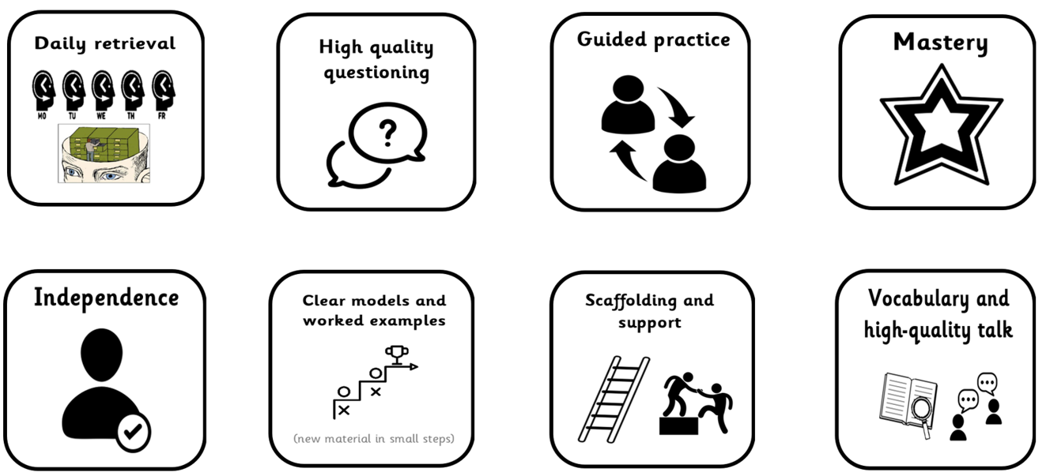
Our toolkit for learning excellence…

Slide 14

Questions?

Slide 15
We can’t wait to welcome you to Year 6 in September!

