Slide 1


Meet the Teacher
Everyday Excellence in Year 3
Class teacher/s:
Mrs Carter, Mrs Stuart, Miss Sawford and Mrs Wynne

Slide 2
Welcome to Year 3!
Welcome to Year 3! We are excited to work with you and your child next year.
Year 3 is an exciting milestone as children move from Key Stage 1 into Key Stage 2.
This year brings new opportunities, greater independence and lots of exciting learning experiences.

Slide 3

Staffing Structure in Year 3
 | Monday | Tuesday | Wednesday | Thursday | Friday
A.M | Mrs Carter | Mrs Carter | Mrs Carter | Mrs Stuart | Mrs Stuart
P.M | Mrs Carter | Mrs Carter | Mrs Carter | Mrs Wynne | Miss Sawford
We value a strong partnership between home and school and know that children thrive when we work together.
We will always try to respond to received DoJo messages as quickly as possible. However, please be aware that we cannot respond during the school day, when we are teaching.
Also, any messages sent to specific staff members on non-working days will be responded to on our next working day.

Slide 4
The move from Key Stage 1 to Key Stage 2
The transition from Year 2 to Year 3 is an important step in your child's education.
Children (and adults) will notice:
Higher expectations for independence.
Longer periods of concentration and learning.
Greater responsibility for their organisation and belongings.
More opportunities to explain their thinking and work independently.
A broader and more challenging curriculum.
This transition is carefully supported, and children are given time to settle into new routines and expectations.

Slide 5
What changes in Year 3?
Learning becomes more independent
Children are encouraged to:
Read and follow instructions independently.
Organise their equipment and belongings.
Take increasing responsibility for completing tasks.
Edit and improve their own work.
Greater challenge and depth
Children will:
Complete longer pieces of writing.
Solve more complex mathematical problems.
Explain and justify their answers and ideas.
Develop greater resilience when learning feels challenging.
Increased expectations
We expect children to:
Listen carefully and follow instructions.
Persevere when tasks are difficult.
Learn from mistakes and feedback.
Take pride in the presentation of their work.

Slide 6

The Year 3 Curriculum:
Year 3 follows the National Curriculum for England and builds upon the learning from Key Stage 1.
Highlights include:
Developing fluency and confidence in reading.
Writing longer and more detailed pieces across a range of genres.
Building secure understanding of number and calculation.
Learning and applying times tables knowledge.
Studying exciting topics in science, history, geography, art and computing.

Slide 7

Times Tables in Year 3
A major focus in Year 3 is developing multiplication and division fluency.
By the end of Year 3, children should be increasingly confident with:
2 times table
3 times table
4 times table
5 times table
8 times table
10 times table
Top Tip!
Little and often practice is far more effective than occasional longer sessions.
TTRS recommends 3 minutes daily as the most effective way for children to practice times table recall.

Slide 8

The Single Most Important Thing You Can Do at Home:
Just 5-10 minutes of reading 5 times a week makes a huge difference.
Children who do not read regularly at home make significantly less progress than those who do.

Slide 9

Learning Behaviours for Success in Year 3:
The most successful learners are
not always the quickest learners.
We want children to develop:
Resilience - keeping going when learning is difficult.
Independence - trying first before asking for help.
Organisation - remembering equipment.
Curiosity - asking questions and showing interest.
Responsibility - taking ownership of their learning.
Confidence – making mistakes is an important part of learning.

Slide 10
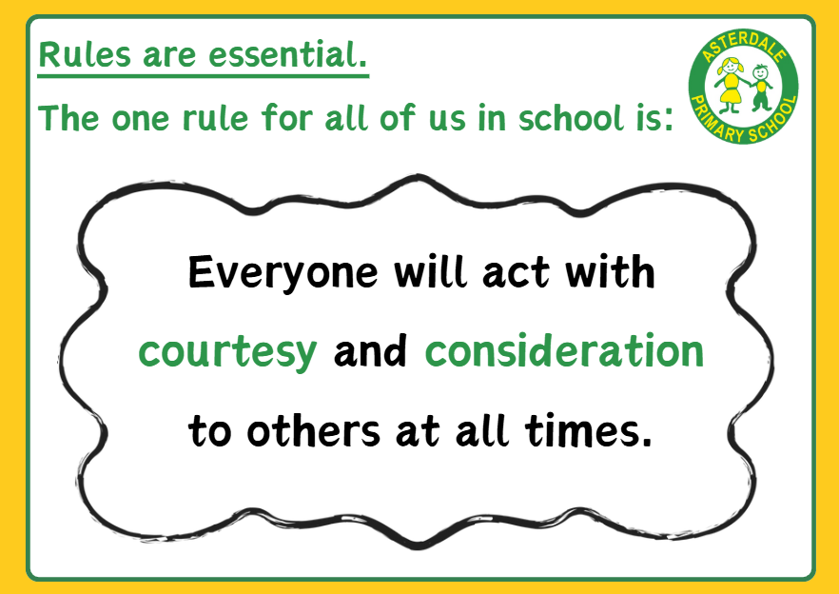

Slide 11

Our vision:
Growing every learner to be the very best version of themselves…

Slide 12

We can’t wait to welcome you to Year 3 in September!
Questions?

Slide 13
School Expectations
Attend school every day
Lateness really impact – be ready, be on time – everyday attendance
School uniform
Correct PE kit
Enrichment
Home-school agreement
Reading – every school day – 5 minutes (at least), 5 times a week
Spellings – practise at home
Progress sharing – reports termly
Effective Parent-Teacher partnership is crucial to ensure
your child makes progress

Slide 14
Key Stage 2:
A broad and balanced curriculum offer.
Children will access learning and teaching in:
Writing
Mathematics
Reading
PE – twice weekly
Art and Design
Religious Education
History and Geography
PSHE
Music
Spanish
Science
Forest School opportunity

Slide 15

Learning at Asterdale…
Enrichment is at the heart of our curriculum approach
Enrichment
Experiences
Connections

Slide 16


Our school values

Slide 17
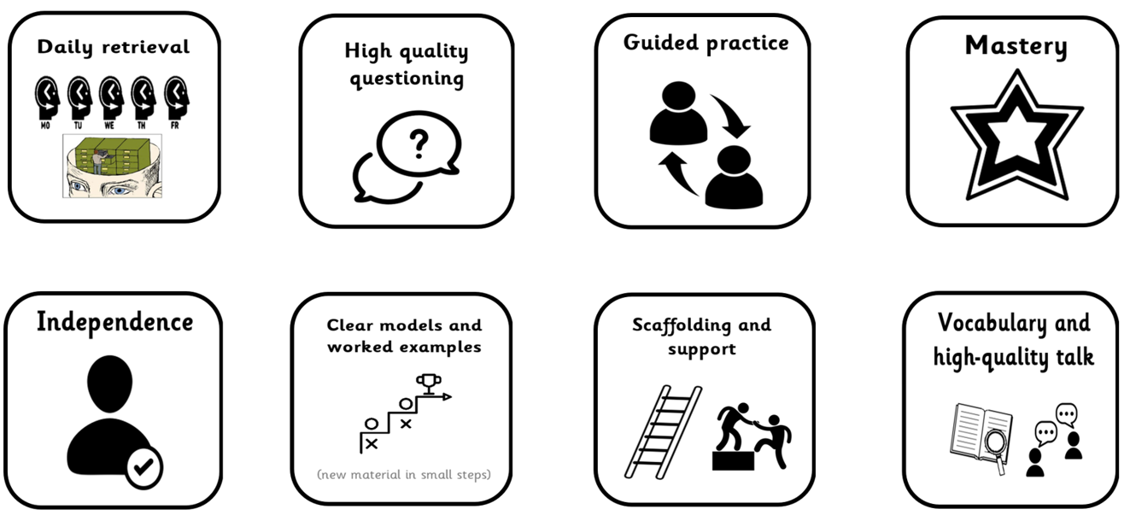
Our toolkit for learning excellence…

