Slide 1


Meet the Teacher
Welcome to Year 5!

Slide 2
Focus
School Expectations
Class Expectations
Year 5 Curriculum
Questions

Slide 3
School Expectations
Attend school every day
Lateness really impacts children’s learning and mental health – be ready, be on time – everyday attendance
Correct school uniform
Correct PE kit
Enrichment opportunities
Reading at home as well as in school
Spellings – practise at home
Progress sharing – reports termly
Effective Parent-Teacher partnership is crucial
to ensure your child makes progress

Slide 4


School Expectations
Children are expected to read for 5-10 minutes, 5 times per week.
This will ensure that your child makes the best possible progress.
Children who don’t read at home, make significantly less progress than those that do.

Slide 5


Our school values

Slide 6
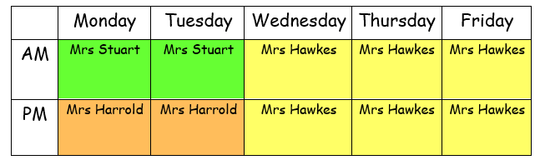

Class Expectations
Who will be teaching in Year 5?
We will try to read and respond to your messages on dojo as soon as possible.
For any urgent matters or change in pick ups etc – please phone the office as we can’t always read messages during the school day.
Try to send messages to the teacher who is in on that day to get the quickest response.

Slide 7

Key Stage 2
Moving from Lower KS2 to Upper KS2.
What is the difference in expectations?
Children are expected to become more independent.
Trying to work through problems independently before asking the teacher.
More oracy opportunities – more in depth discussions.
Longer pieces of writing with more detailed sentences.
A broader more challenging curriculum.
In the summer term – getting the children ready for Year 6.

Slide 8





Year 5 curriculum highlights
English
Biographies, letters, news reports, recounts, leaflets, postcards, narratives.
Maths
Place Value
Addition and subtraction
Multiplication and division
Fractions, decimals and percentages
Area and perimeter
Shape and volume
Statistics

Slide 9
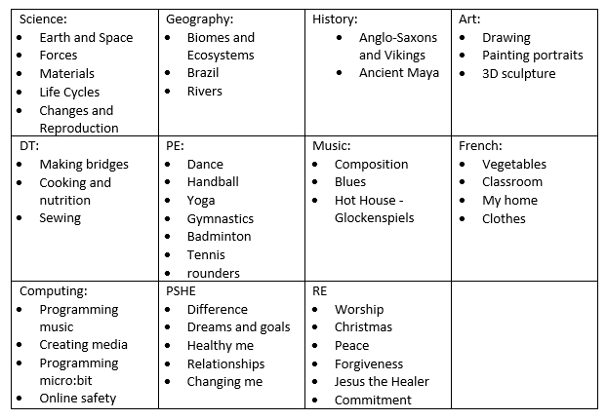
Year 5 curriculum highlights

Slide 10
What does a typical day in Year 5 look like?
Arrive and complete a morning task – handwriting / arithmetic / reading
Spelling activity (10 words learnt per week – test on a Friday. Words will be stuck in reading records)
Maths
Assembly
BREAK
Reading activity
English Writing
LUNCH
Science
BREAK
PE

Slide 11

Questions?
We can’t wait to welcome you to Year 5 in September!

