Slide 1


Meet the Teacher
Everyday Excellence in Year 4
Parents are invited to come along to discuss new year group expectations for children in Year 4 in September on 13th July
If unable to attend, a copy of information shared will be posted via class dojo

Slide 2
Meet the Teacher
Everyday Excellence in Year 4
Class teacher: Mrs Seviour

Slide 3

Our vision:

Slide 4

Our vision:
Growing every learner to be the very best version of themselves…

Slide 5
School Expectations
Class Expectations
Year 4 Curriculum
Questions

Slide 6
School Expectations
Attend school every day
Lateness really impact – be ready, be on time – everyday attendance
School uniform
Correct PE kit
Enrichment
Home-school agreement
Reading – every school day – 5 minutes (at least), 5 times a week
Spellings – practise at home
Progress sharing – reports termly
Effective Parent-Teacher partnership is crucial to ensure
your child makes progress

Slide 7



Slide 8


Our school values

Slide 9
Key Stage 2
A broad and balanced curriculum offer
Writing
Mathematics
Reading
PE – twice weekly
Art and Design
Religion
History and Geography
PSHE
Music
French
Science
Forest School opportunity
Comprehension Crushers - Reading

Slide 10

Year 4
MTC June 2027
Teacher Assessments
Residential
Spelling and Grammar | Reading words per minute fluency | Writing Maths

Slide 11

Learning at Asterdale…
Enrichment is at the heart of our curriculum approach
Enrichment
Experiences
Connections

Slide 12
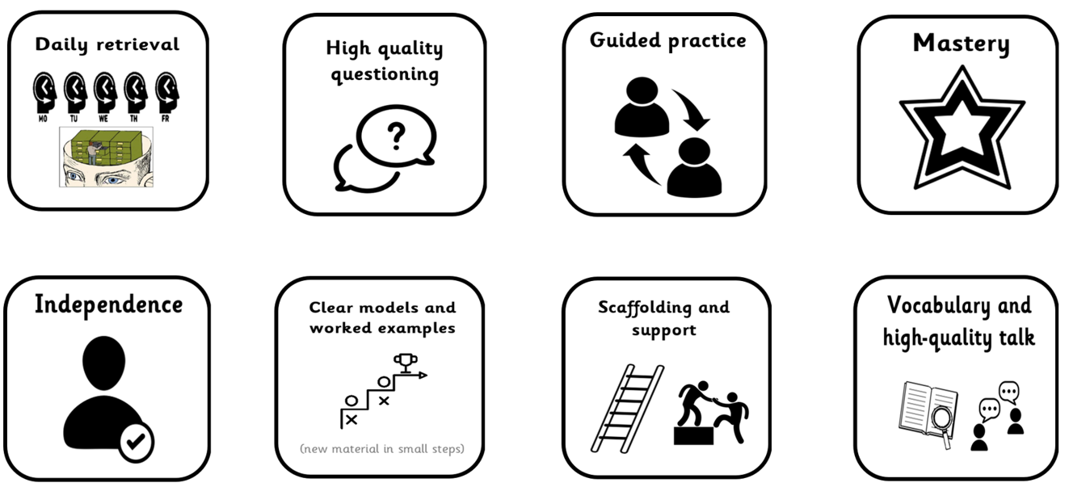
Our toolkit for learning excellence…

Slide 13

Questions

Slide 14
We can’t wait to welcome you to Year 4 in September!

