Slide 1


Meet the Teacher
Everyday Excellence in Year 2
Class teacher: Miss Lomas

Slide 2
School Expectations
Class Expectations
Year 2 Curriculum

Slide 3


Our vision:

Slide 4

Our vision:
Growing every learner to be the very best version of themselves…

Slide 5

School Expectations
Everyday attendance – be ready, be on time
School uniform
Correct PE kit – labelled
Enrichment
Home-school agreement:
Reading – every school day – 5 minutes (at least), 5 times a week
Spellings/handwriting – practise at home
Progress sharing – report cards termly
Class dojo updates, learning posts and half termly newsletters

Slide 6
Key Stage 1
A broad and balanced curriculum offer
Writing and handwriting
Mathematics – Mastering Numbers
Reading
PE
Art and Design
Design and technology
Religious Education
History and Geography
PSHE – My Happy Minds
Music
French
Science
Forest School opportunity
Phonics – recaps/rapid catch up/spellings
Seeds of Happiness/Picture News

Slide 7
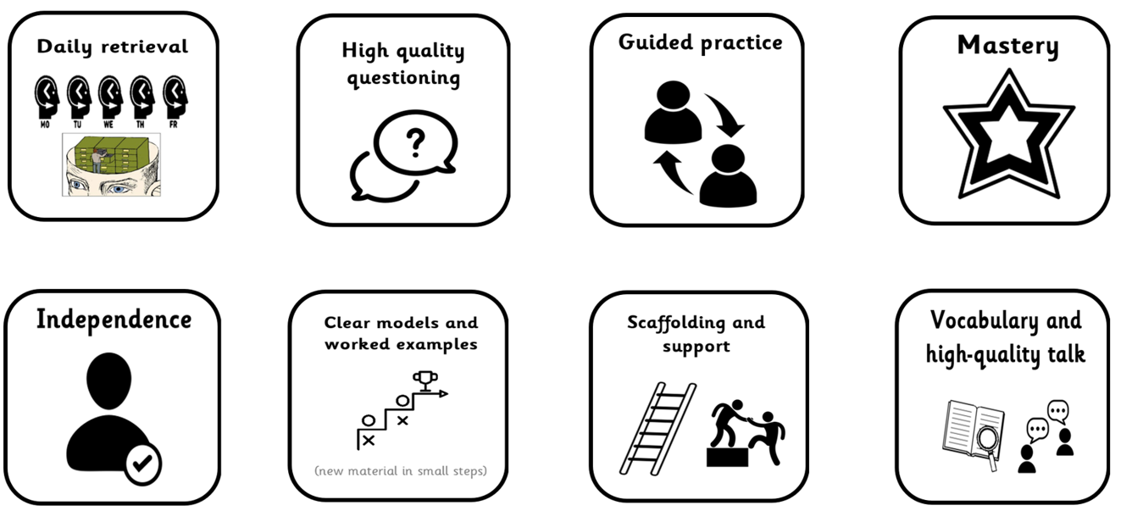
Our toolkit for learning excellence…

Slide 8

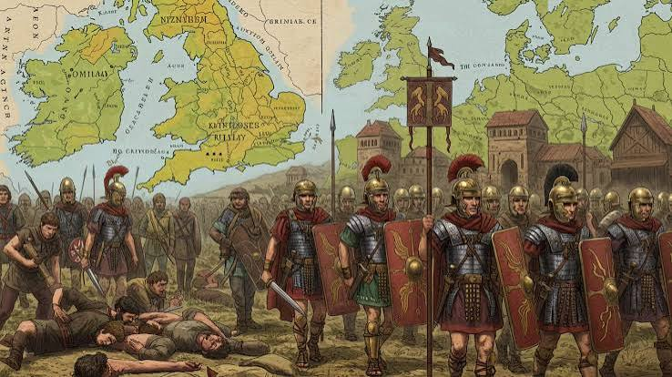


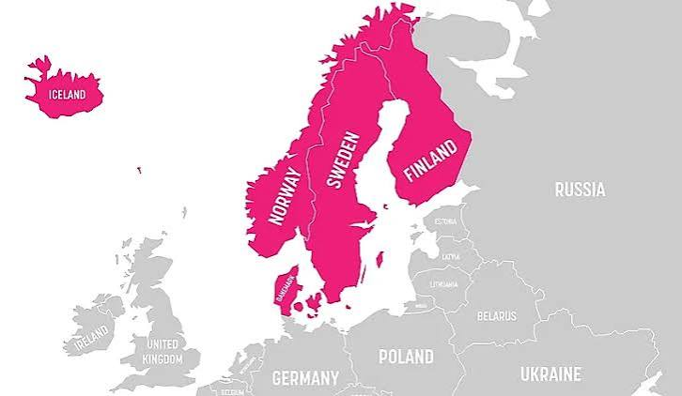

Year 2 is all about…
Mastering Key Stage 1 skills
Reading comprehension
Learning away trips
Increasing independence
Dance enrichment

Slide 9

Year 2
End of Key Stage 1 – increasing responsibility
Teacher Assessment
Reports
Writing Spelling and grammar consistency | Reading 90 words per minute fluency | Maths Numbers 1-100 2s, 5s and 10s

Slide 10

Learning at Asterdale…
Enrichment is at the heart of our curriculum approach
Enrichment
Experiences
Connections

Slide 11

We can’t wait to welcome the children to Year 2 in September!

